Slide 1
Project Title
Online Car Rental System

Slide 2





Technology Used
Front End
Back End

Slide 3
Objective of Online car rental system : -
In my Online Car Rental System, user can simply register and login to the website and then , they can rent the cars according to their preferences (brand , color , price).
Project Description
No. of Modules | 5 - 7
No. of Tables | 4
Technology Used | 5

Slide 4
Tables and Schemas
Register
Login
email
Password
Car Details
Price
Phone No.
My Bookings
PK | Id
 | Name
 | Email
 | Password
 | Mobile
PK | Id
 | Phone No.
 | Email
 | Date
 | With Drivers

Slide 5
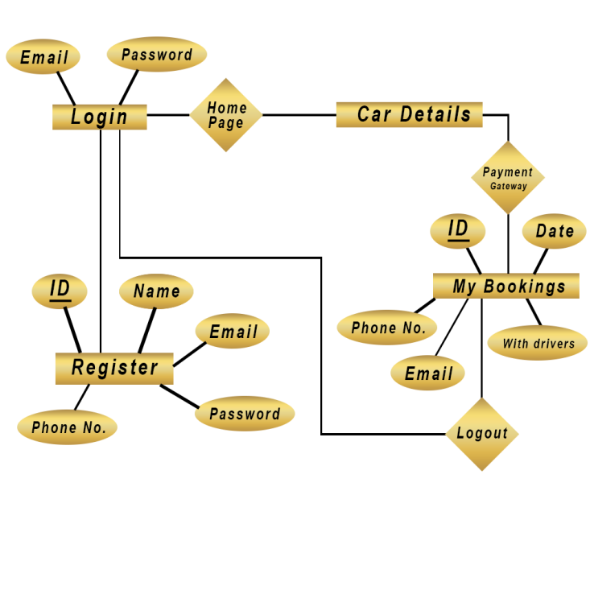
ER-Diagram for Online Car Rental System
Thank You

